Slide 1
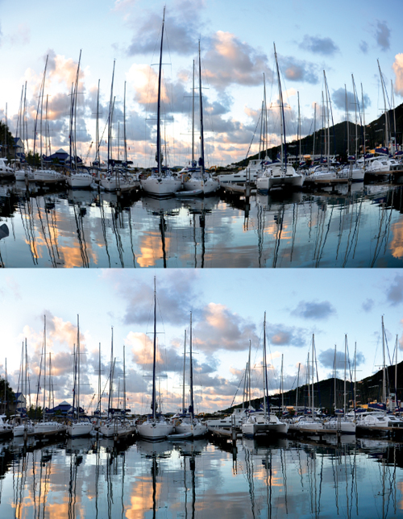
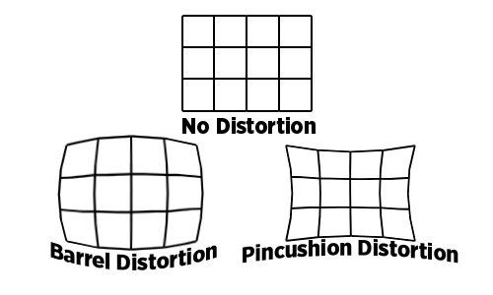
Camera lens distortions
f = focal length
c_{x} = principal point x coordinate
c_{y} = principal point y coordinate
k_{n} = n^{th} radial distortion coefficient
p_{n} = n^{th} tangential distortion coefficient
skew coefficient between the x and the y axis.
k₁ <1
k₁ >1

Slide 2
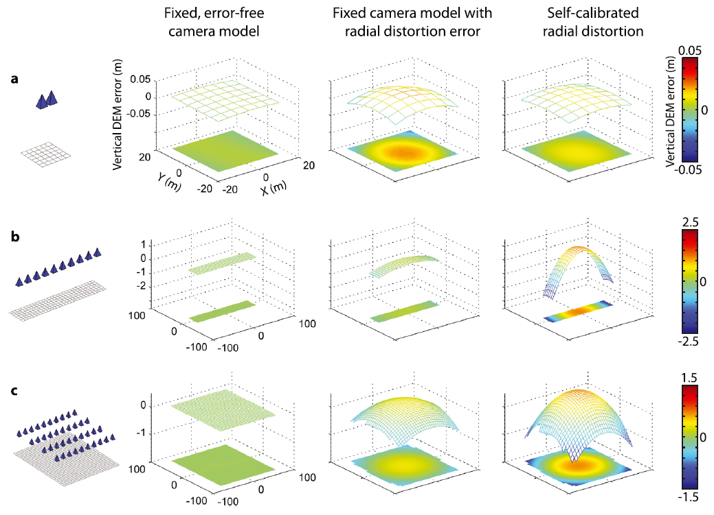
Camera lens distortions
• A trade-off between lens radial distortion term and computed surface form can lead to “doming”
James & Robson (2014), Mitigating systematic error in topographic models derived from UAV and ground-based image networks, Earth Surface Processes and Landforms

Slide 3
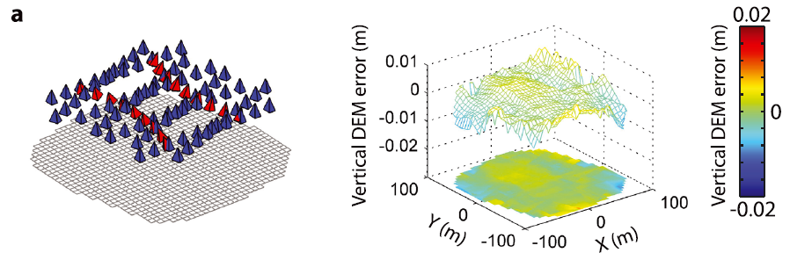
Camera lens distortions
• Doming can be mitigated by incorporating a few oblique camera angles (in red)
James & Robson (2014), Mitigating systematic error in topographic models derived from UAV and ground-based image networks, Earth Surface Processes and Landforms

Slide 4
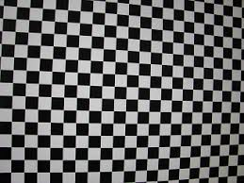
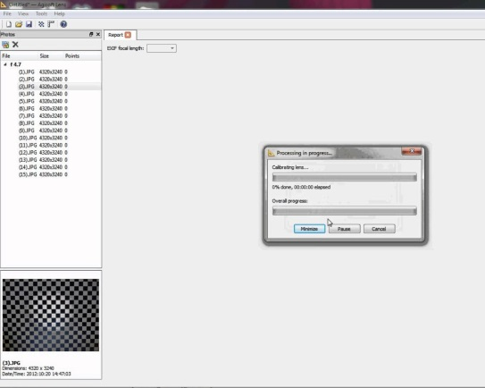
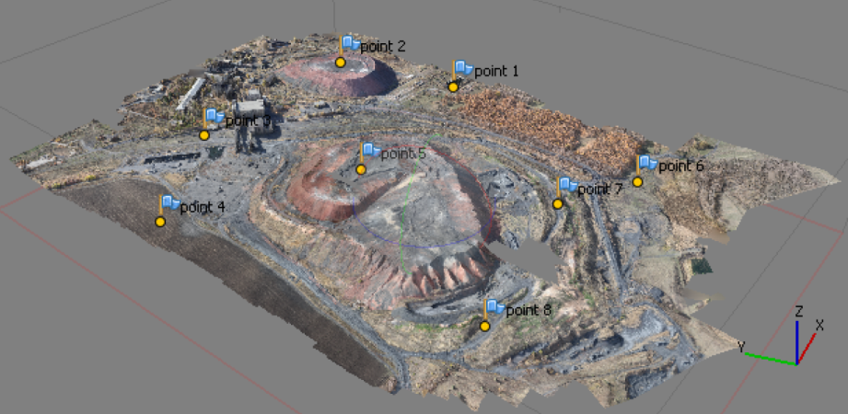
Camera lens distortions
• Doming can be mitigated by calibrating the camera parameters by photographing a calibration target
• Doming can be mitigated by georeferencing using ground control points
• Doming can be mitigated by incorporating a few oblique camera angles (in red)

Slide 5
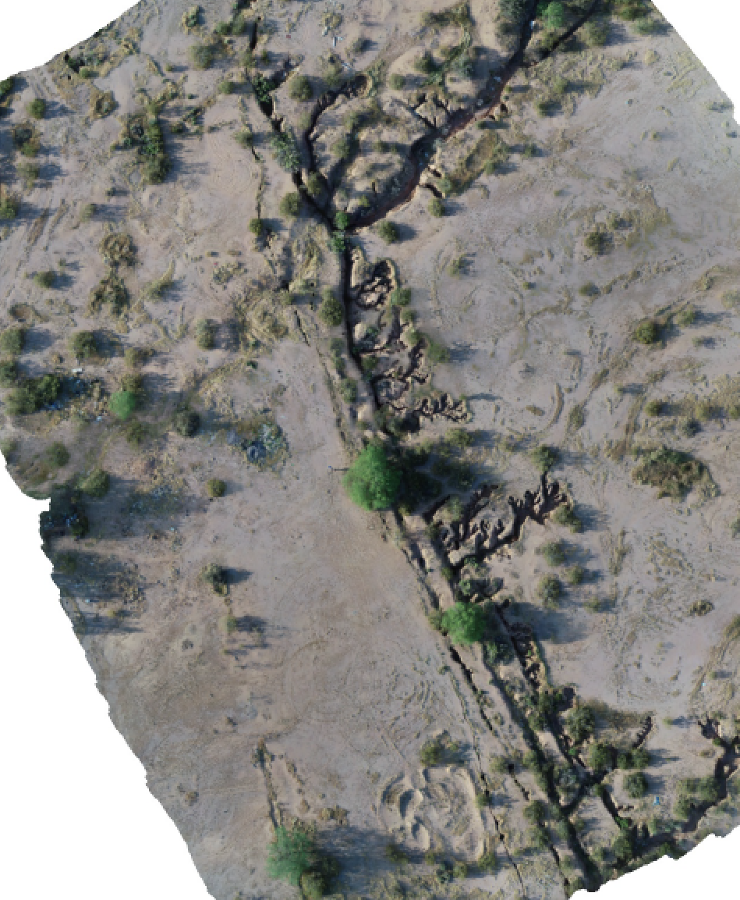
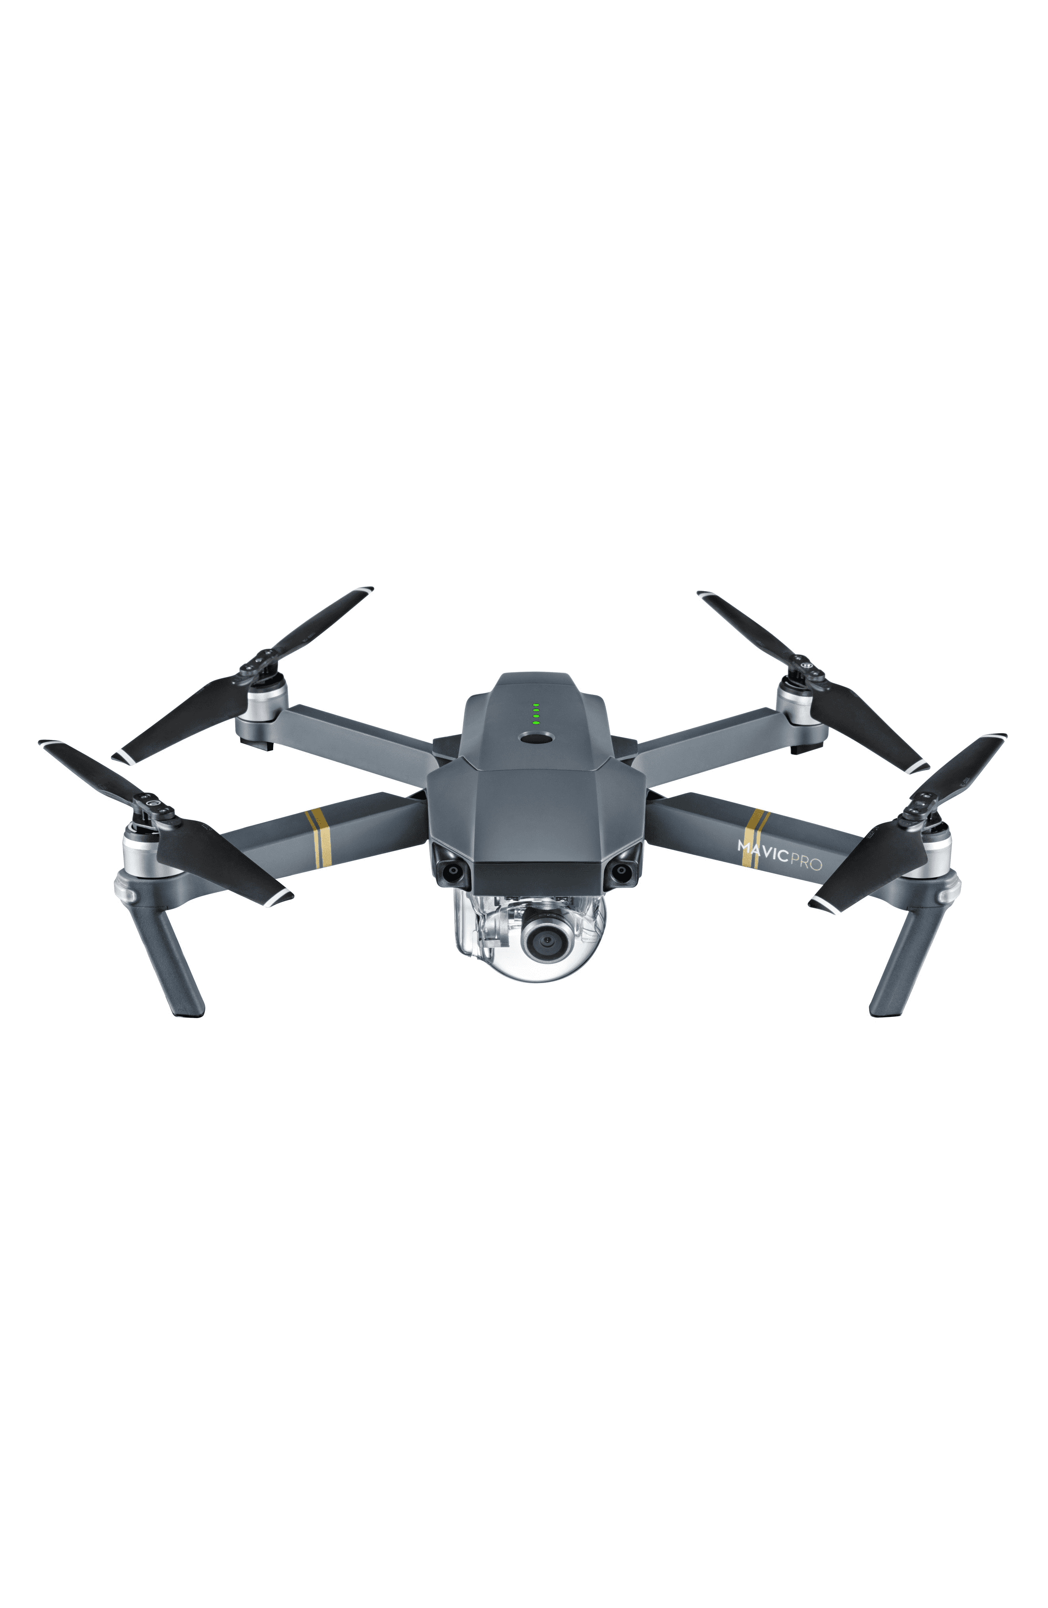
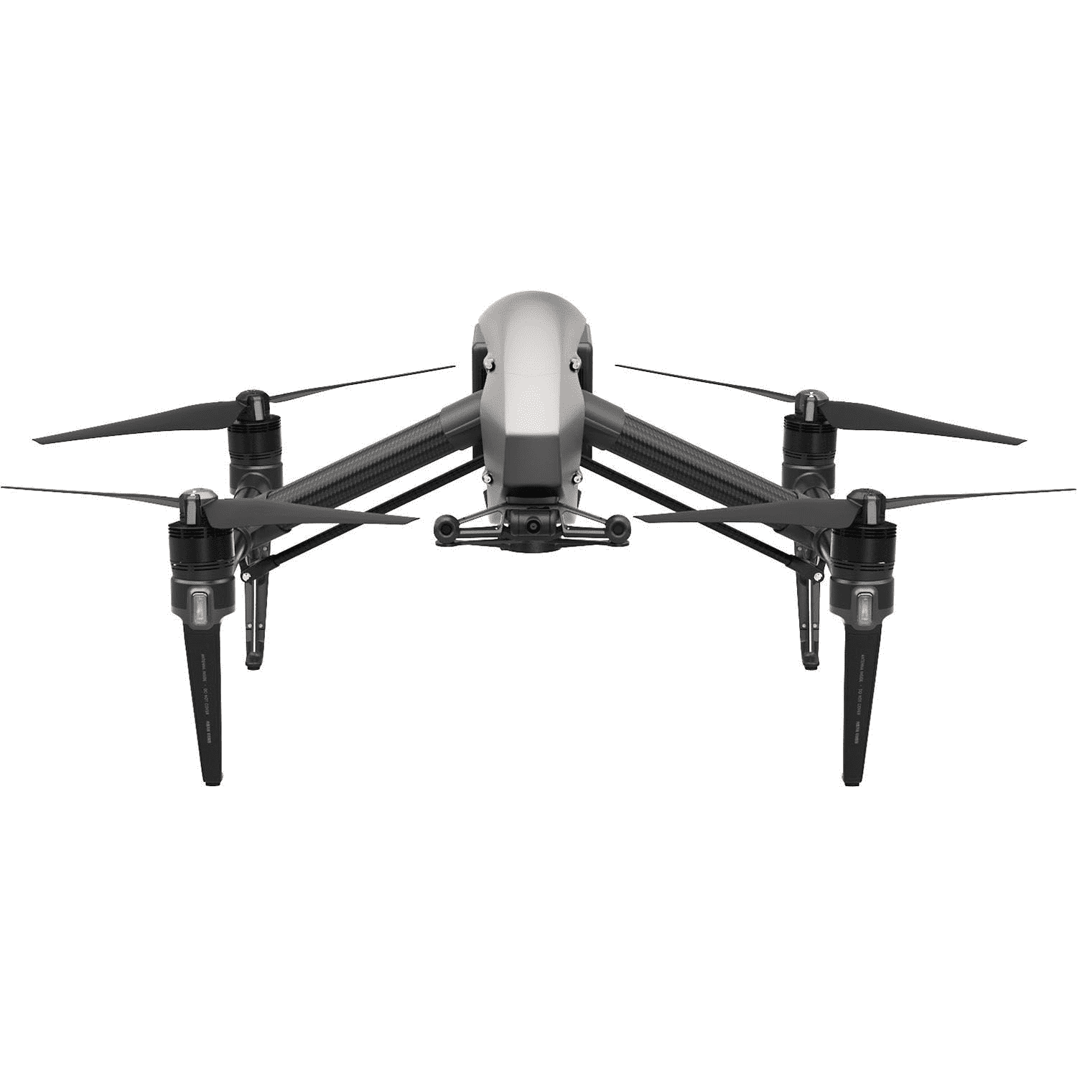
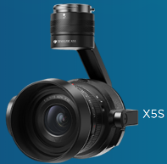
Spring 2019 “fly off”—Earth Fissures in Apache Junction, AZ with Alan Deino and David Feary (+others)
DJI Mavic Pro (Deino)
DJI Inspire 2 + ZenMuse camera (Feary)

Slide 6
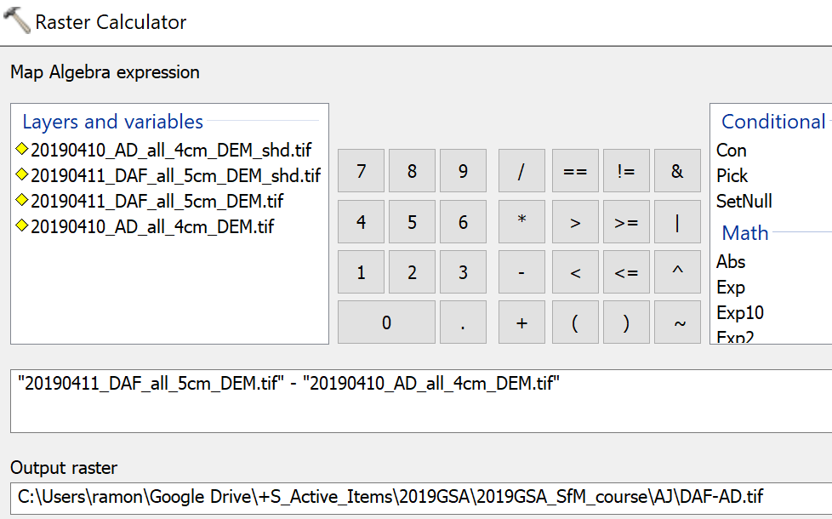
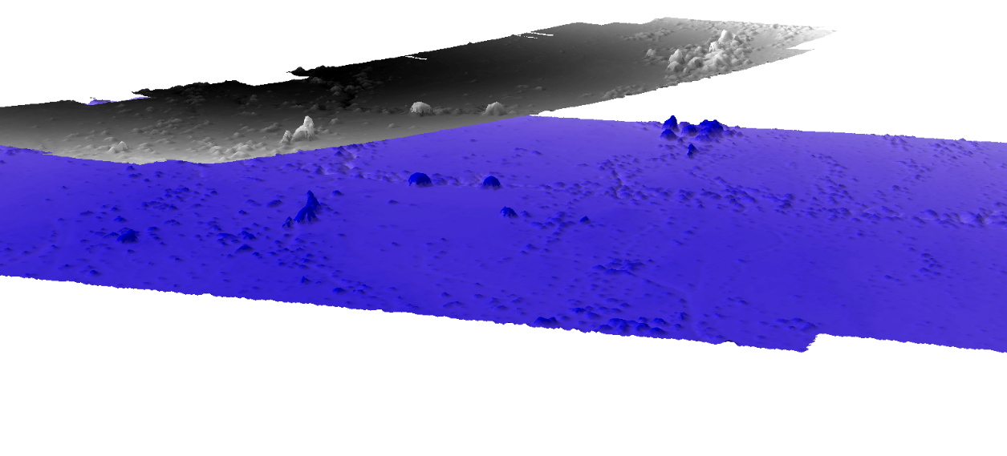
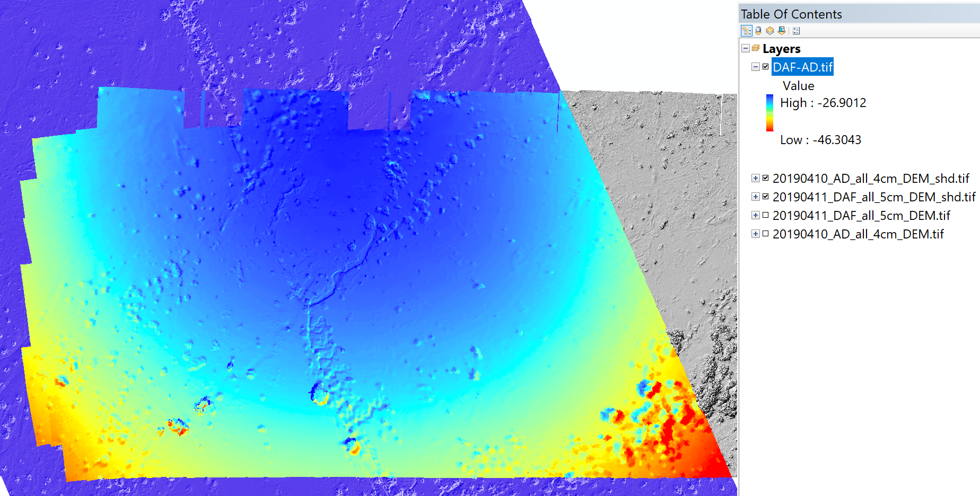
DEM Comparison: No GCPs, only on board GPS
Mavic
Inspire + ZenMuse

Slide 7
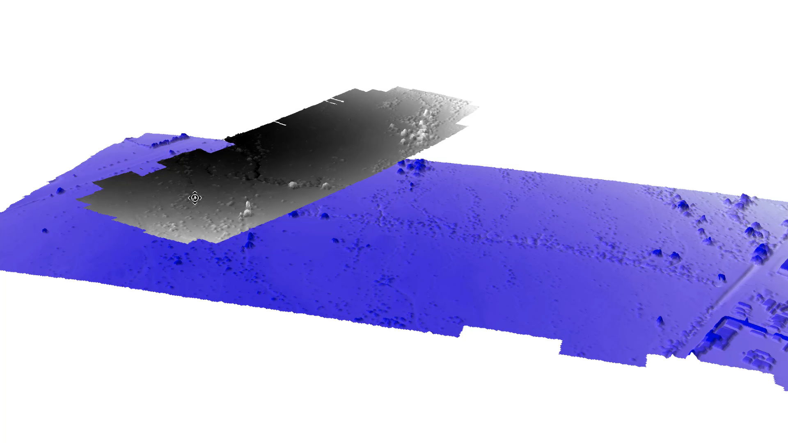
Notice the magnitude and sign of the “doming”
Grey surface is the Mavic
Blue surface is the Inspire + ZenMuse

